Slide 1
Computer Hardware

Slide 2
How a computer works
Computers work using binary digits (abbreviated as “bits”)
A single bit can be either 0 or 1 (off or on)
Computers use sequences of bits to digitally represent:
Data
Numbers
Text characters (letters, punctuation marks, etc.)
Sounds
Pictures and video
Instructions (computer programs)
What to do with the data

Slide 3
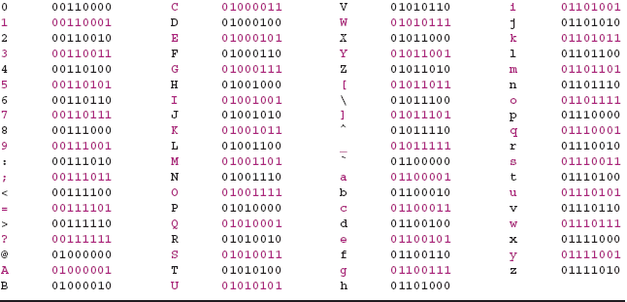
How a computer works, Cont’d.
Representing text characters with sequences of bits

Slide 4
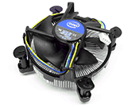
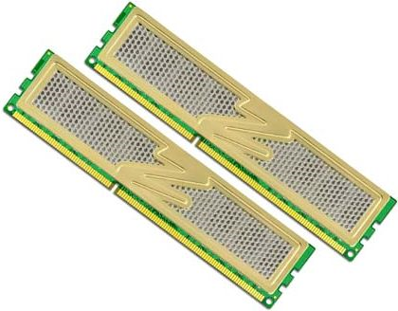
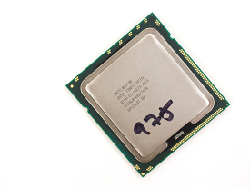
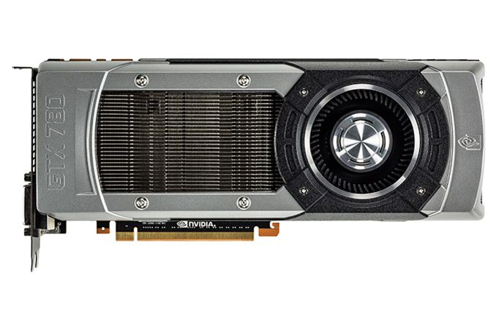
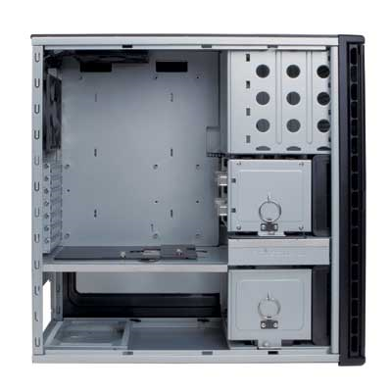
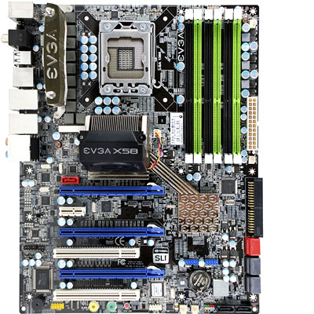
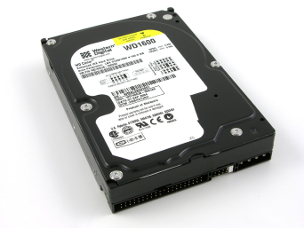
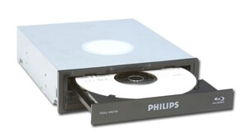
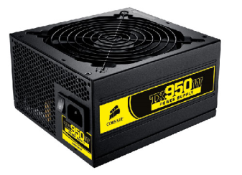
Computer hardware components
Main memory (RAM)
Heatsink / fan
CPU
Graphics card (GPU)
Case
Power supply unit (PSU)
Storage devices
(hard drive, optical drive)
Motherboard

Slide 5
How a computer works, Cont’d.
The three most important computer components:
Central processing unit (processor/CPU)
Random access memory (RAM)
Storage
Storage
Data and installed programs are permanently kept in storage
When a program is started, its data is copied into memory (this is because memory is generally much faster than storage)
The processor executes (runs) the program by fetching the loaded program instructions from memory
Program is loaded into memory
Results from processor are placed into storage and/or memory
Memory
Processor reads program instructions from memory
Processor
Processor executes program instructions

Slide 6
Processors
The processor is the “brain” of the computer
Processor speed (“clock speed”) is measured in Hertz (Hz) – cycles per second
1 MHz = 1 megahertz = 1,000,000 cycles per sec
1 GHz = 1 gigahertz = 1,000,000,000 cycles per sec
During each cycle, the processor grabs an instruction from RAM and executes it (fetch-and-execute cycle)
Instructions are expressed in a binary machine language specific to the processor
Faster clock speed = more instructions executed per second = faster running programs

Slide 7
Processors, Cont’d.
Many processors have an onboard cache to store recently executed instructions / data
Accessing information from the cache is even faster than reading it from RAM
Processor will try to read from cache before trying to read from RAM
Processors may have multiple cache “levels” – e.g., L1, L2, L3
L1 cache is checked first, then L2, then L3, then RAM
Cache design is a complex topic!

Slide 8
Processors, Cont’d.
Processors are also rated by word size and number of cores
Word size indicates how much data can be processed each cycle – a 64-bit processor can read instructions twice as long as a 32-bit processor can
A multi-core processor contains more than one processing unit on a single chip (2, 3, 4, 6, or even 8)
Processors are manufactured by several companies:
Intel produces Core, Pentium, Celeron, Atom, and Xeon for PCs
AMD produces FX, Athlon, Sempron, and Opteron for PCs
Motorola and IBM produced PowerPC for Apple Macintosh in the past

Slide 9
Some Intel desktop CPUs
Year First Introduced | Processor Name | Speed | Word Size | Number of Cores
1982 | 286 | 6 MHz – 25 MHz | 16 bits | 1
1989 | 486 | 16 MHz – 133 MHz | 32 bits | 1
1993 | Pentium | 60 MHz – 300 MHz | 32 bits | 1
2000 | Pentium 4 | 1.3 GHz – 3.8 GHz | 32 or 64 bits | 1 or 2
2006 | Core 2 Duo/Quad series | 1.8 GHz – 3.33 GHz | 64 bits | 2 or 4
2008 | Core i7 series | 2.66+ GHz | 64 bits | 4, 6, 8, or 10

Slide 10
Memory
RAM (random access memory) is a temporary holding area for data, running programs, and the computer’s operating system
Also known as main memory, primary memory
“Waiting room” for the processor
Very fast access compared to storage
When a program starts, it is loaded into RAM and remains there until the program is closed
More RAM = more programs/data able to remain open at the same time
Most RAM is volatile, which means it needs electrical power to hold data
If the computer loses power, data in RAM is lost

Slide 11
Memory, Cont’d.
Memory and storage capacity is measured in bits and bytes
1 bit = one binary digit (0 or 1) (abbreviated lowercase “b”)
1 byte = 8 bits (abbreviated uppercase “B”)
More bits/bytes = more 0’s and 1’s that can be held!
Metric, but not quite…
In the context of memory/storage, the prefix kilo- (uppercase “K”) usually means 1024, rather than 1000
Prefix mega- (uppercase “M”) means 1024 x 1024 = 1,048,576
Prefix giga- (uppercase “G”) means 1024 x 1024 x 1024 = 1,073,741,824
Some people use the prefixes kibi-, mebi-, gibi- (“Ki”, “Mi”, “Gi”) for powers of 1024, to avoid confusion with the standard metric prefixes

Slide 12
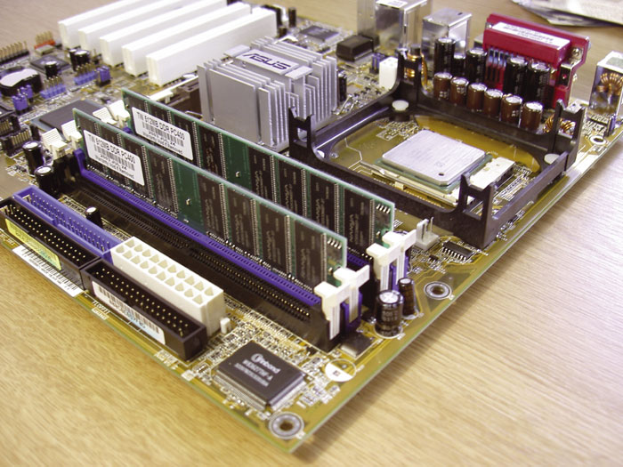
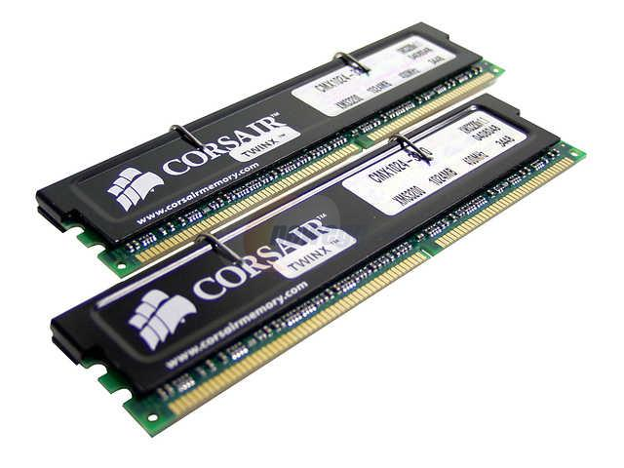
Memory, Cont’d.
RAM (above), mounted on a motherboard (left)

Slide 13
Memory, Cont’d.
Some computers have graphics cards with dedicated video memory (VRAM)
Video memory is used to store graphics data
Separate from the computer’s main RAM
In computers without a dedicated graphics card (e.g., most business PCs), graphics data must share main RAM with other programs

Slide 14
Storage
Storage provides permanent space for data / programs
Also known as secondary memory
The hard disk drive (HDD) is the main storage device in most computers
Slower access than RAM, but usually faster than other types of storage
Some HDD performance measures:
Capacity: how much information the disk can store (usually in GB – higher is better)
Access time: how long it takes to get a piece of data from the disk (usually in milliseconds – lower is better)
Revolutions per minute (RPM): how fast the disk spins (higher means better performance)
Read/write throughput: how fast data can be read from / written to the disk in a sustained manner (usually in MB/s – higher is better)

Slide 15
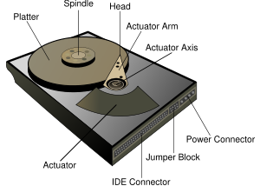
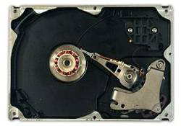
Storage, Cont’d.
Traditional hard drive – magnetic storage with mechanical read/write head
(Diagram credit: Wikipedia)

Slide 16
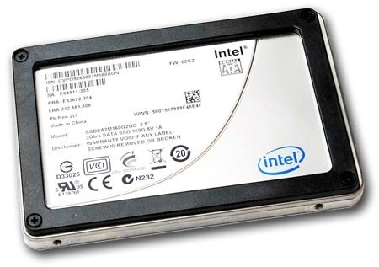
Storage, Cont’d.
Solid state drive (SSD) – uses the same storage technology as USB flash drives, no moving parts
Still relatively expensive, but prices are steadily falling

Slide 17
Hard Drive Performance Comparison | Traditional, mainstream (Seagate Barracuda 7200.14) | Traditional, high-end (Toshiba AL13SXB600N) | Solid-state (Samsung 850 Pro)
Access time | 8.7-15.0 ms | 2.1-4.9 ms | 0.03-0.04 ms
Rotational speed | 7,200 rpm | 15,000 rpm | N/A
Avg. read throughput | 154.6 MB/s | 194.6 MB/s | 526.4 MB/s
Avg. write throughput | 153.5 MB/s | 193.9 MB/s | 481.3 MB/s
Capacity | 2000 GB | 600 GB | 512 GB
Cost (early 2016) | $99.95 | $350 | $227.99
Cost per GB | $0.05 | $0.58 | $0.45
Performance and pricing data from Tom’s Hardware (www.tomshardware.com)

Slide 18
Storage, Cont’d.
Optical drives
A CD (compact disc) provides 650-700 MB of storage
A DVD (digital video disc or digital versatile disc) is a variation with a capacity of 4.7 GB
Recent-ish developments: HD-DVD (15 or 30 GB, now defunct), Blu-Ray (25 or 50 GB)
Optical discs come in several varieties:
Read only (ROM) – permanent data stored during manufacturing; cannot be overwritten
Recordable (R) – initially blank; data can be written once, but it can’t be changed
Rewritable (RW) – can be changed many times, much like a hard drive but much slower

Slide 19
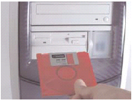
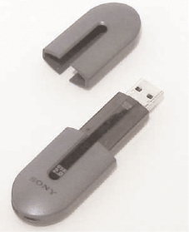
Storage, Cont’d.
Other storage devices
Floppy disk
5.25”, 720 KB
3.5”, 1.44 MB
“Zip” disk
100 - 750 MB
USB flash drive
Also called “thumb drive,” “jump drive,” “USB stick”
Most common portable storage device today
Up to 64+ GB
Tape drives

Slide 20
How big is a MB or a GB?
1 MB = 1,048,576 bytes
Mostly-text Microsoft Word document: < 0.1 MB
Low-quality smartphone photograph: ~1 MB
Typical mp3 file of a song: ~5-8 MB
Personal space available on UMdrive: 500 MB
1 GB = 1,073,741,824 bytes
Typical RAM on a personal computer: A few GB
Typical smartphone capacity: Dozens of GB
Typical hard drive capacity: Thousands of GB

Slide 21
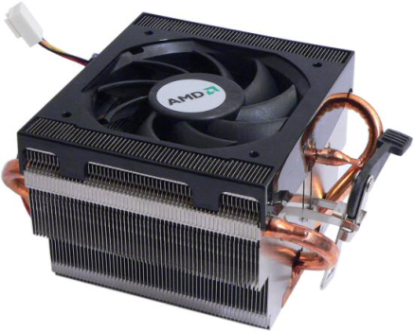
Other computer components
Power supply unit (PSU)
Converts power from wall outlet to a form suitable for system components
Motherboard
Main circuit board of the computer, provides connection points for all other components
Includes a socket for the CPU
Some motherboards include more than one socket
Heatsinks and fans are used to dissipate heat from computer components (a CPU heatsink/fan is pictured here)

Slide 22
Other components, Cont’d.
Graphics card or video card (sometimes called graphics processing unit, GPU) handles displaying things on monitor, performing display-related computations
Essential for computer-aided design, most modern games
Modern GPUs are mostly designed by either Nvidia (the GeForce product line) or AMD (the Radeon product line)
Network card connects to high-speed networks (wired and/or wireless)
Modem connects to networks via phone lines (slow!)
Sound card handles producing sound
Many motherboards include integrated versions of the above (usually less powerful and/or include fewer features than standalone versions)

